Slide 1

Weather UI App Full stack : BackEND FronTEND Your Name: Guy Yarhi Cycle: DS17 2024

Slide 2

AGENDA
Introduction
Architecture
Workflow and Execution
Development Environment
System –Flow Diagram
Summary

Slide 3

Introduction

Slide 4

Weather Data Application
Overview:
This application interfaces with a weather server to fetch and display weather data.
Components:
1. Server Side (Weather Server):
Provides data via API.
2. Our App (Frontend and Backend):
Displays data using Streamlit and handles backend logic.

Slide 5
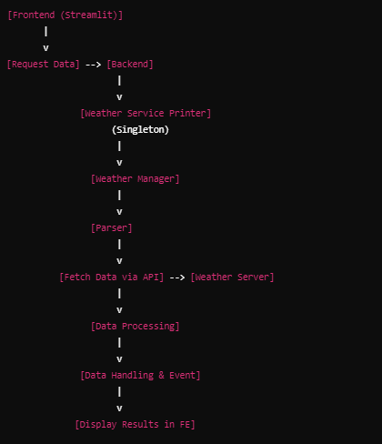
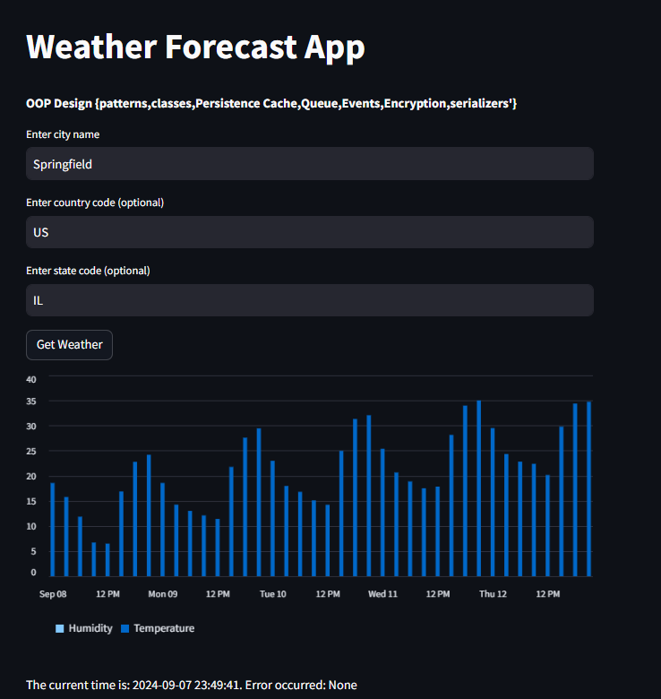


Slide 6
Architecture

Slide 7
system Architecture
Server Side (Weather Server):
API Server → Database → Client Request.
Our App:
Frontend (FE): Streamlit for displaying data.
Interaction: Requests data from the Backend (BE).
Backend (BE):
Weather Service Printer: Singleton class handling connections and data printing.
Weather Manager: Manages requests, processes data, and handles events.
Parser: Fetches data from Weather Service via API and processes it.

Slide 8
system architecture
Frontend:
Streamlit for data display.
Backend:
Weather Service Printer
Weather Manager
Parser
Libraries and Techniques:
Abstract Base Classes: Define common interfaces for different parsers.
Event Handling: Asynchronous operations and event-driven architecture.
Singleton Pattern: Ensures single instance of Weather Service Printer.
Encoding Utilities: Base64 UTF-8 encoding for secure API key management

Slide 9
system architecture
Additional Notes:
Separation of Concerns: The architecture maintains a clear modular structure.
Process Flow:
Request Data: From Frontend to Backend.
Data Processing: Backend retrieves data via API from Weather Service.
Display Data: Results are shown on the Frontend using Streamlit.
Flexibility and Extensibility: Abstract base classes and event handling support flexible and asynchronous operations.

Slide 10
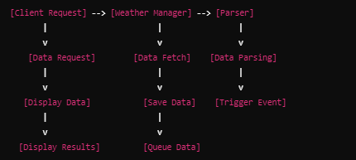
Workflow
Client Request: App requests data from the API server.
Weather Manager: Directs requests to the appropriate parser.
Parser: Fetches and processes data, converting it to a specific model.
Data Handling: Data is saved and events are triggered.
Queue Management: Weather Manager handles the data in a queue.

Slide 11
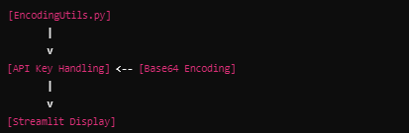
Development Environment
Backend:
Language: Python 3.11
Framework: Streamlit for frontend display.
PyCharm:
Using: Microservices, Cache. Events, Network, Encoding, queue, serializer
Utilities: EncodingUtils.py for encoding operations.
Frontend:
Framework: Streamlit
API Key Handling: Base64 UTF-8 encoding for secure key storage.

Slide 12
Diagram Flow

Slide 13

diagram Flow of the System
Process Flow:
Request Data: From frontend to weather server.
Data Processing: Through Weather Manager and Parser.
Display Data: Results shown in Streamlit frontend.

Slide 14
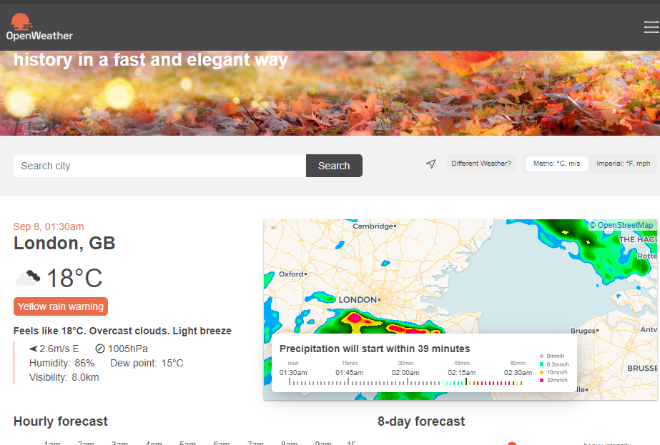
System Diagram Flow
Detailed Interaction:Weather Service Printer: Singleton class managing connections.
Weather Manager: Manages data requests and queue processing.
Parser: Specific to each URL query.
API Server

Slide 15
Summary

Slide 16
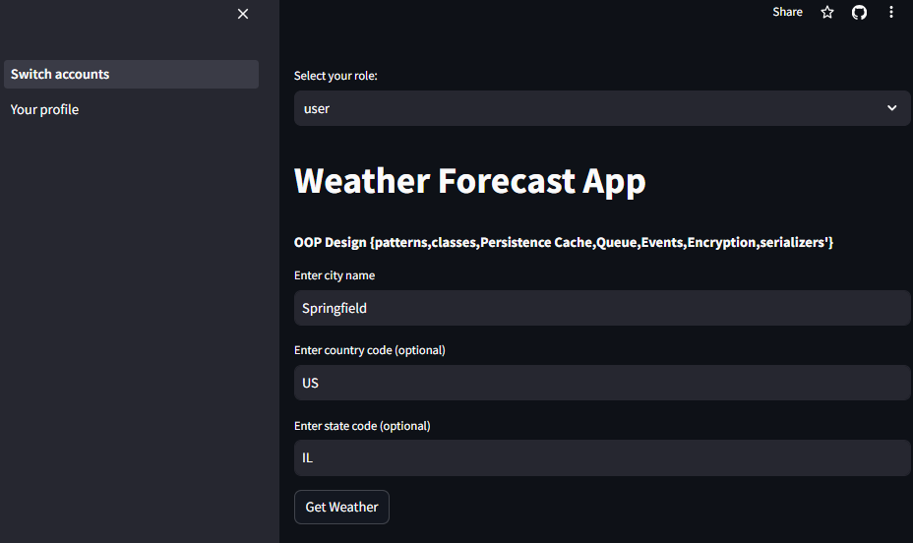
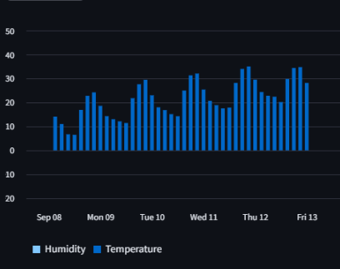
Summary
Purpose: Efficiently fetch, process, and display weather data.
Components:
Server Side: Provides data.
Backend: Manages requests and processing.
Frontend: Displays results using Streamlit.
Future Considerations: Support for multiple GUI requests and handling bursts of queries.

Slide 17

THANK YOU

